Slide 1
Pre-Assessment Questions
  Which class is used to read primitive data types, such as int, float, and double from an input stream?
    DataInputStream
    FileInputStream
    BufferedInputStream
    SequenceInputStream
  Identify the class that supports the out variable of the standard output stream.
    FileOutputStream class
    PrintStream class
    PipedOutputStream class
    ByteArrayOutputStream class

Slide 2
Pre-Assessment Questions (Contd.)
  3. Which method clears the buffers by removing any buffered output written on the disk?
      skip()
      flush()
      mark()
      close()
  Identify the default size of a memory buffer that is used to store data temporarily.
      1028 bytes
      512 bytes
      64 bytes
      128 bytes

Slide 3
Pre-Assessment Questions (Contd.)
  Which method ignores the specified number of bytes of data from an input stream?
    flush()
    mark()
    skip()
    read()

Slide 4
Solutions to Pre-Assessment
Questions
  a. DataInputStream
  b. PrintStream class
  b. flush()
  b. 512 bytes
  c. skip()

Slide 5
Objectives
  In this lesson, you will learn about:
    Character stream classes
    Object serialization

Slide 6
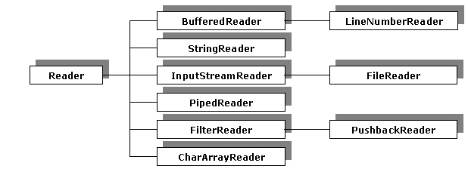
Implementing Character Stream Classes
  Using the Reader Class
    The java.io.Reader class is an abstract class that provides various methods for reading the Unicode character data from input devices, such as hard disk, keyboard, and memory.
    Reader class hierarchy

Slide 7
Implementing Character Stream Classes(Contd.)
    Methods of the Reader class
Method
Description
int read()
Reads a single character and returns an integer value of the character read. Returns –1 if the end of file is encountered.
int read(char buffer[])
Reads character into the character array buffer[] and returns the actual number of characters that are successfully read. Returns –1 if the end of file is encountered.

Slide 8
Implementing Character Stream Classes(Contd.)
  Methods of the Reader class (Contd.)
Method
Description
abstract int read(char buffer[], int offset, int len)
Reads the number of characters specified by the len parameter into buffer starting at the position specified by the offset parameter and returns the number of characters successfully read. Returns –1 if the end of file is encountered.
abstract void close()
Closes the stream.

Slide 9
Implementing Character Stream Classes(Contd.)
  Methods of the Reader class (Contd.)
Method
Description
void mark(int num)
Places a mark at the current character in the stream that remains valid until the numbers of characters that are specified by num parameter are read.
void reset()
Resets the pointer to the previously set mark.
long skip(long num)
Skips the number of characters specified by the num parameter and returns the number of characters that are skipped.

Slide 10
Implementing Character Stream Classes(Contd.)
    The FileReader Class
      The FileReader class is used for reading characters from a file, but it does not define any methods of its own.
    The BufferedReader Class
      The BufferedReader stream reads text from a character input stream and attaches a buffer to the character input Streams.

Slide 11
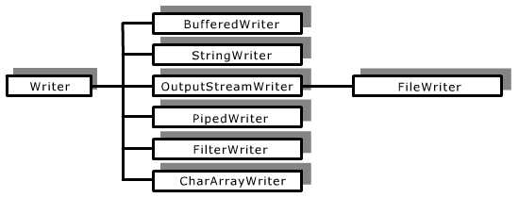
Implementing Character Stream Classes(Contd.)
  Using the Writer Class
    The java.io.Writer class is an abstract class that provides various methods for writing the Unicode character data to the output devices, such as hard disk and monitor.
    Writer class hierarchy

Slide 12
Implementing Character Stream Classes(Contd.)
      Methods of the Writer class
Method
Description
void write(int ch)
Writes a character into the character-output stream.
void write(char buffer[])
Writes a character array into the character-output stream.
abstract void write(char buffer[], int offset, int len)
Writes the number of characters specified by the len parameter from the character array starting at buffer[offset] to the character output stream.

Slide 13
Implementing Character Stream Classes(Contd.)
      Methods of the Writer class
Method
Description
abstract void close()
Closes the character output stream.
void write(String str)
Writes a string specified by the str parameter to the character output stream.
void flush()
Flushes the output buffer.

Slide 14
Implementing Character Stream Classes(Contd.)
    The FileWriter Class
      Constructors of the FileWriter class
Constructor
Description
FileWriter(String filename)
Creates an object of the FileWriter class where filename specifies the name of the object.
FileWriter(String filename, boolean appendData)
Creates an object of the FileWriter class. The filename parameter specifies the name of the object. The appendData parameter is a boolean variable that indicates whether to append data to the specified file or not.

Slide 15
Implementing Character Stream Classes(Contd.)
        Constructors of the FileWriter class
Constructor
Description
FileWriter(File fileObj)
Creates a FileWriter class object where fileObj parameter is an object of the File class.

Slide 16
Implementing Character Stream Classes(Contd.)
    The BufferedWriter Class
      The BufferedWriter class extends the Writer class and writes text to a character output stream.
    The PrintWriter Class
      The PrintWriter class extends the Writer class and writes the formatted character to the character output stream. This class defines various methods, such as print() and println() that provide formatted output.
      Constructors of the PrintWriter class
Constructor
Description
PrintWriter(OutputStream OStream)
Constructs an object of the PrintWriter class from the OStream object of the OutputStream class.

Slide 17
Implementing Character Stream Classes(Contd.)
Constructor
Description
PrintWriter(OutputStream OStream, boolean autoflush)
Constructs an object of the PrintWriter class from the Ostream object of the OutputStream class. If the value of the autoflush parameter is true then the println() method flushes the output buffer.
PrintWriter(Writer outWriter, boolean autoflush)
Constructs an object of the PrintWriter class where outwriter is an object of character output stream. If the value of the autoflush parameter is true then the println() method flushes the output buffer.

Slide 18
Implementing Character Stream Classes(Contd.)
      Methods of the PrintWriter class
Methods
Description
void print(boolean b)
Prints a boolean value.
void print(int b)
Prints an integer value.
void print(char[] b)
Prints an array of characters.
void print(Object obj)
Prints an object.

Slide 19
Implementing Character Stream Classes(Contd.)
Methods
Description
void println()
Terminates the current line by placing the line separator string.
void println(boolean b)
Prints a boolean value and then terminates the current line.

Slide 20
Implementing Object Serialization
  Serializing Objects
    Serializing objects is the process of writing objects to a file. When an object is serialized, its state and other attributes are converted into an ordered series of bytes. This byte series can be written into streams.
    Interfaces and Classes that support Serialization
      The Serializable interface
      The ObjectInputStream class
      The ObjectOutputStream class
    Serializable Interface
      The Serializable interface is used for serializing objects in Java and does not define any method. An object that is saved and restored by the serialization process must implement the Serializable interface.

Slide 21
Implementing Object Serialization (Contd.)
  Using the ObjectOutputStream Class for I/O Operations
    The ObjectOutputStream class extends the OutputStream class and implements the ObjectOutput interface.
    Methods of the ObjectOutputStream class
Methods
Description
public void writeObject(Object obj) throws IOException
Writes the obj object to the ObjectOutputstream stream.
public void flush() throws IOException
Ensures that the data stored in the buffer is written to a file to which the stream is connected.
public void close() throws IOException
Closes the stream and releases all the resources occupied by the stream.

Slide 22
Implementing Object Serialization (Contd.)
  The transient keyword
    The data members of a class that are not required to be serialized are declared as transient. The serialization process ignores the transient variables.
  Using the ObjectInputStream Class for I/O Operations
    The ObjectInputStream class extends the InputStream class and implements the ObjectInput interface.
Methods
Description
public final Object readObject() throws IOException,ClassNotFoundException
Reads an object from ObjectInputStream.

Slide 23
Implementing Object Serialization (Contd.)
Methods
Description
public void close() throws IOException
Closes a stream and releases the resources occupied by the stream.
public String readLine() throws IOException
Reads a line that has been terminated by End Of File (EOF) or the new line character (\n).

Slide 24
Implementing Object Serialization (Contd.)
      A class implements the Serializable interface in order to serialize its objects. The class that implements the Serializable interface may be a user-defined class.

Slide 25
Summary
  In this lesson, you learned:
  The use and implementation of the character stream classes in Java for reading or writing of character-oriented data.
  The use and implementation of various subclasses of the Reader class, such as the BufferedReader, FileReader, and InputStreamReader classes to read text from the character streams.
  The use and implementation of various subclasses of the Writer class, such as the BufferedWriter, FileWriter, and PrintWriter classes to write text to the character streams.
  Object serialization and its implementation using the Serializable interface.

